Slide 1

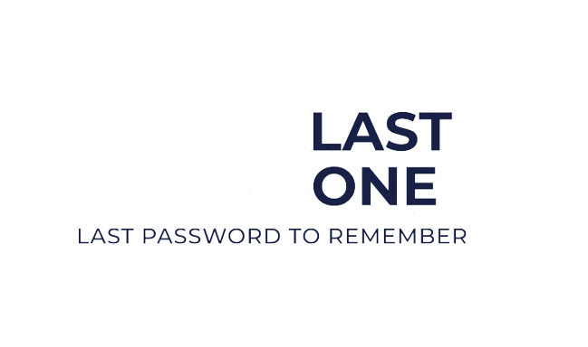

PASSWORD GENERATOR AND MANAGER

Slide 2
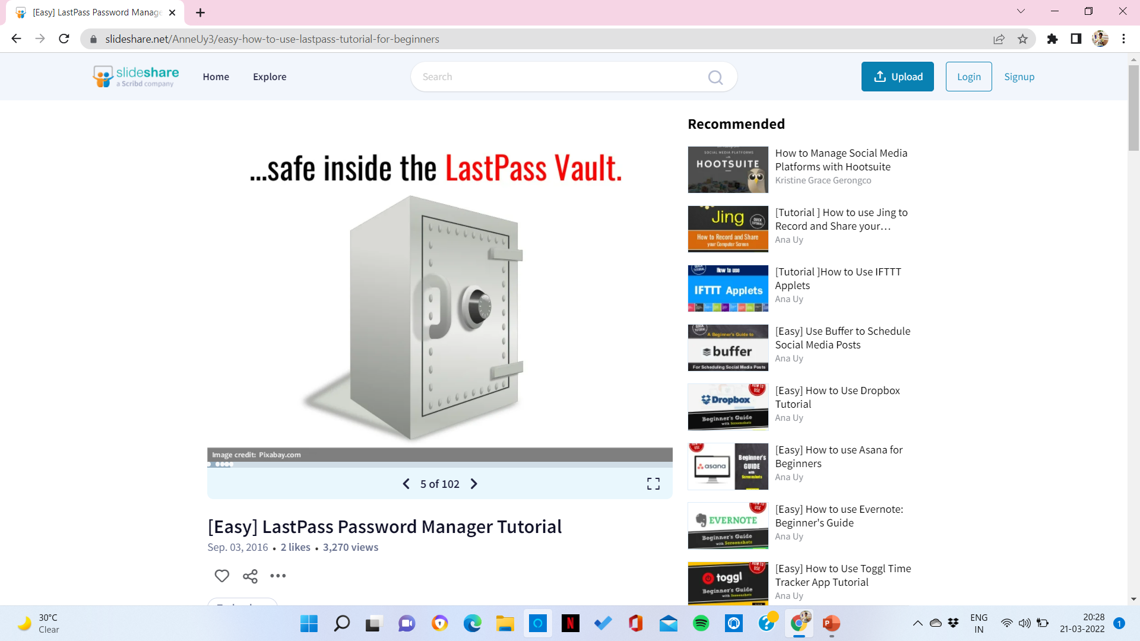
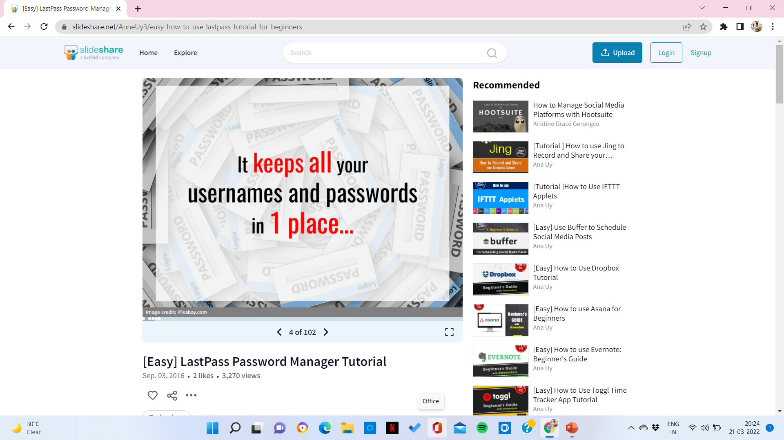
Last one is a free,online password manager
Safe in the last one vault

Slide 3
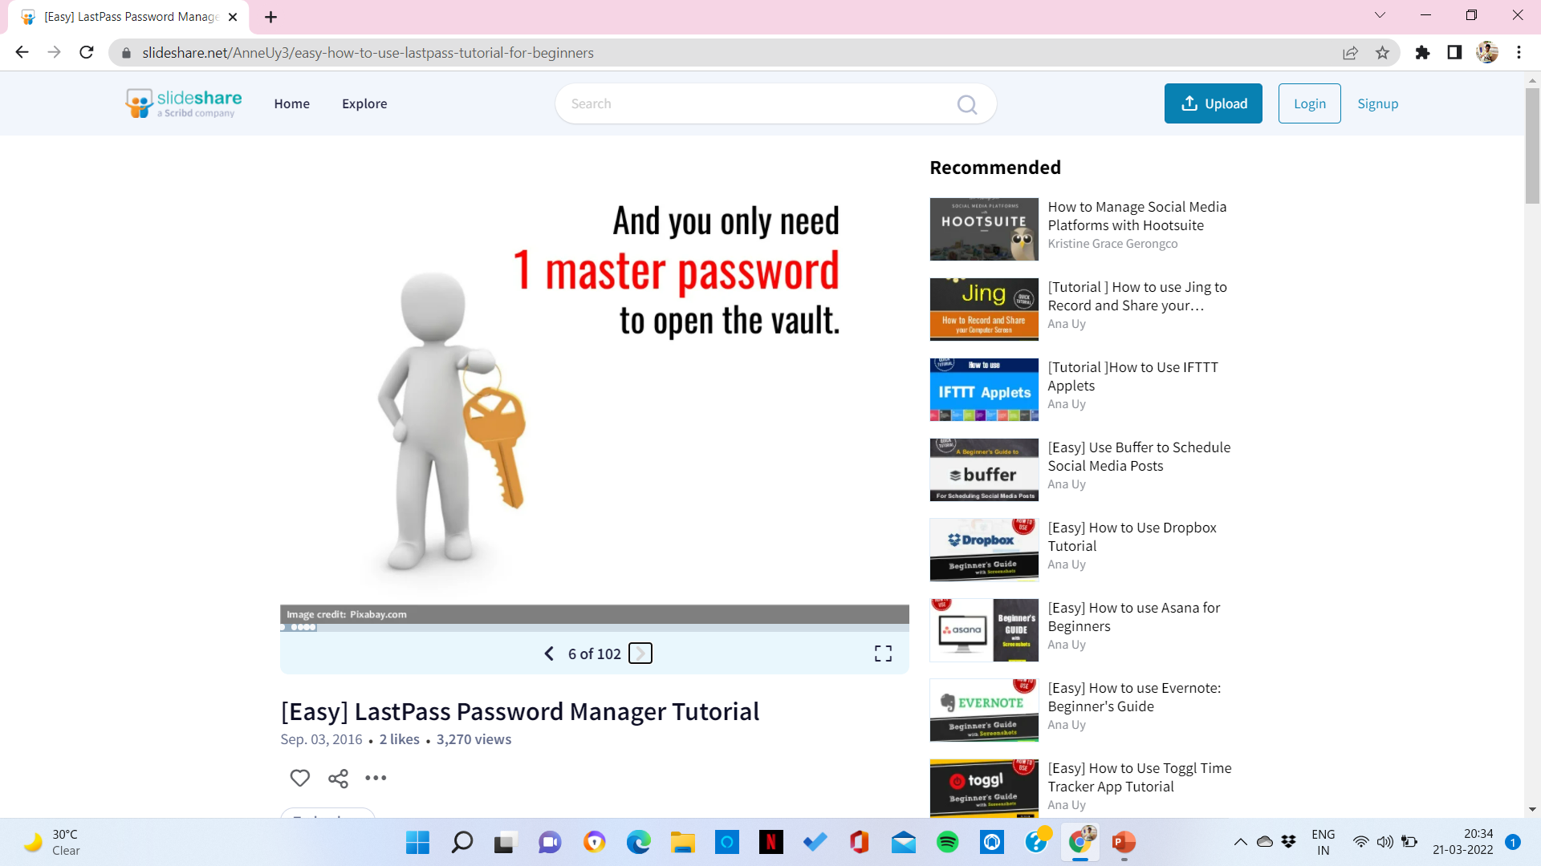
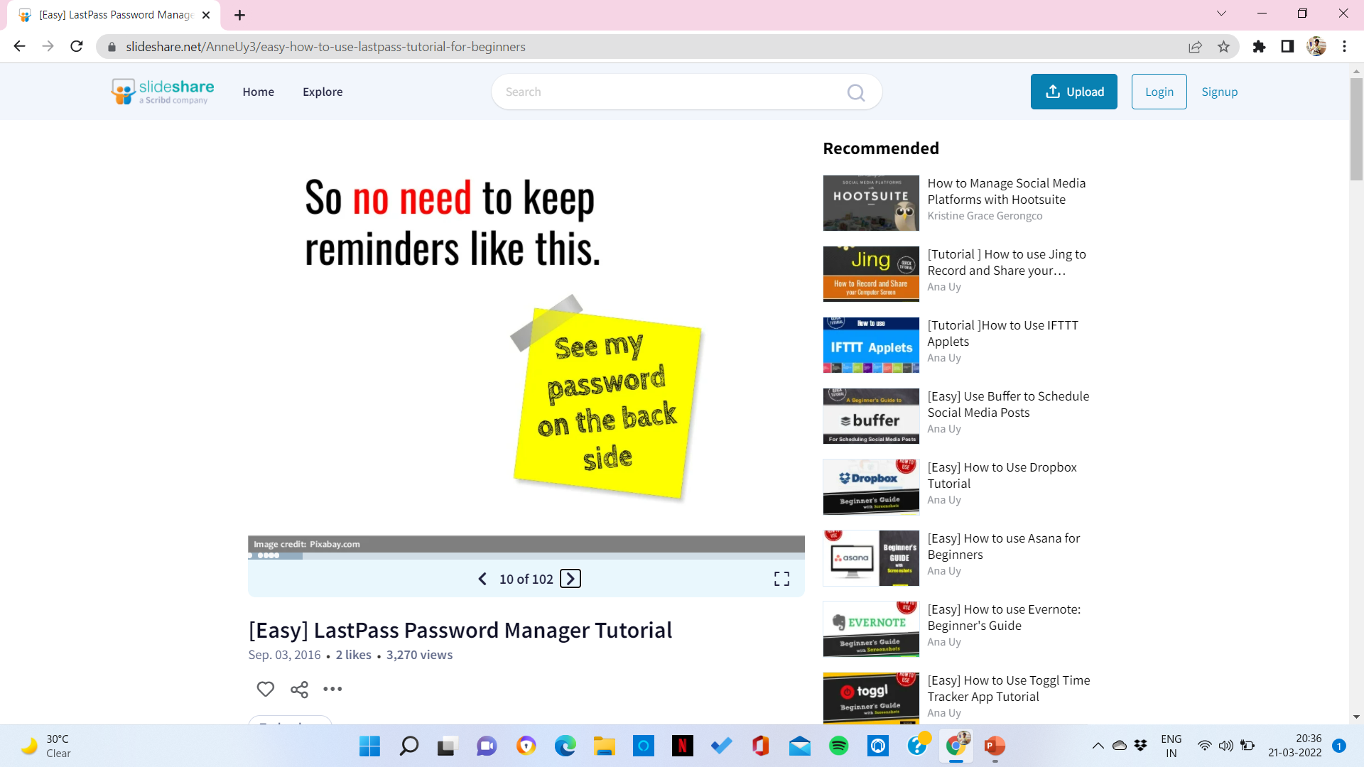
LAST ONE

Slide 4
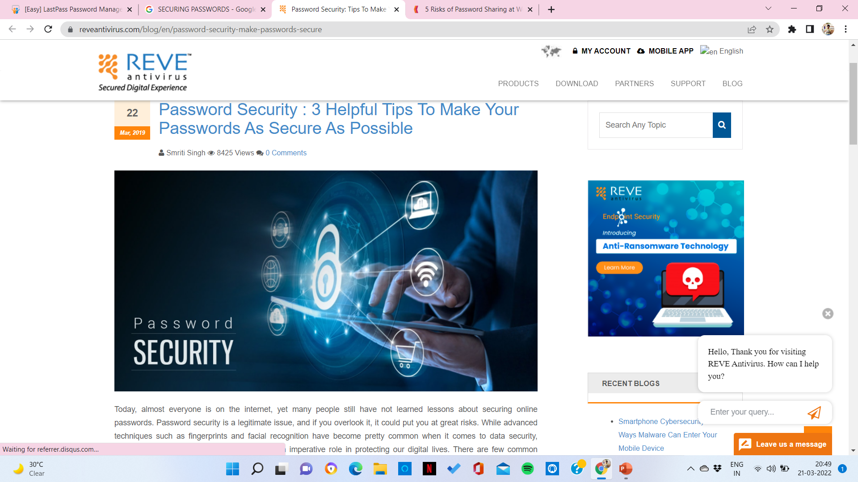
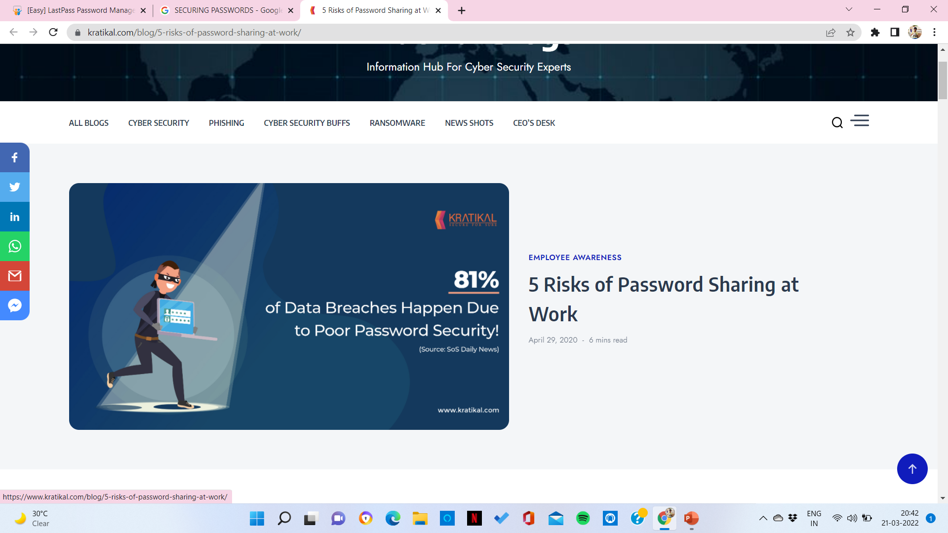
LAST ONE
IT CAN ALSO GENERATE STRONG PASSWORDS
IT HAS GOOD ENCRYPTION

Slide 5
PROBLEM STATEMENT
The “PROJECT LAST ONE” is an attempt to make a program that allows the user to:
To create strong passwords.
This project helps in managing all different types of passwords in one place.
This project gives the user a software to create a highly encrypted password.
It removes the worry of data-breach, by giving alerts to the user when a information at risk.
The worry of remembering passwords no longer exist.

Slide 6
PASSWORD GENERATION AND MANAGING
The customer are prompted to register if he/she is a new user to store the details or login if he/she is a returning user.
This helps in creating a highly encrypted and random password with desired specifications(i.e lowercase letters, uppercase letters, characters and numbers.
This helps in storing and managing all your old and new created passwords.

Slide 7
OBJECTIVE AND UNIQUENESS OF OUR PROJECT
The main goal of this project is to give the user a easy and user friendly software to create strong passwords and manage them all under one place.
This project helps the user to create a strong password by letting the user choose the specification of the password like word-length, uppercase and lowercase letters, numbers and special characters.
This project has a very simple and easy to use user-interface.
In this software, you can create limitless number of passwords and manage them.

Slide 8
LOGIN PAGE
DASHBOARD
YOUR ACCOUNT
PASSWORD GENERATOR
PASSWORD MANAGER
LOGOUT
SET SPECIFICATIONS
PERSONAL DETAILS
ADD/REMOVE PASSWORDS
EXIT
RECOVERY EMAIL
LETTERS
NUMBERS
CHARACTERS
VIEW/MODIFY
RECOVERY PHONE NUMBER
GENERATE PASSWPRD

Slide 9


